Slide 1
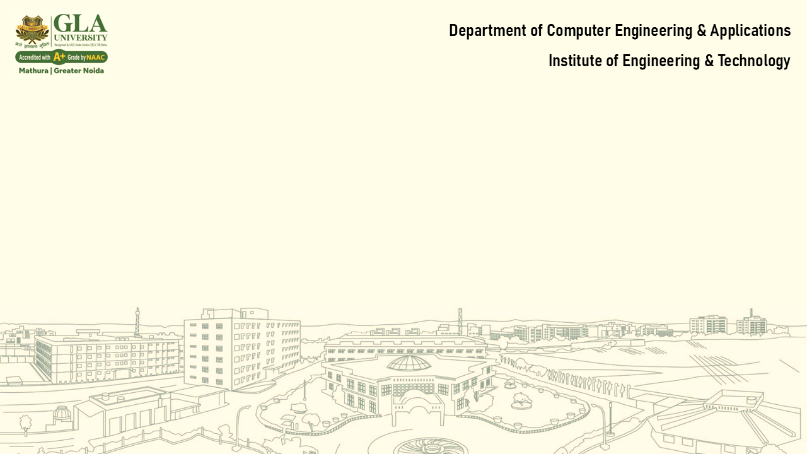
Lecture 1: Introduction to Operating Systems & System Architecture
Core Topics:
What is an Operating System?
Functions of Operating System
Types of OS: Batch, Time-sharing, Distributed, Real-time, etc
Kernel, Shell, System Calls
System Architecture: Monolithic, Microkernel, Layered

Slide 2
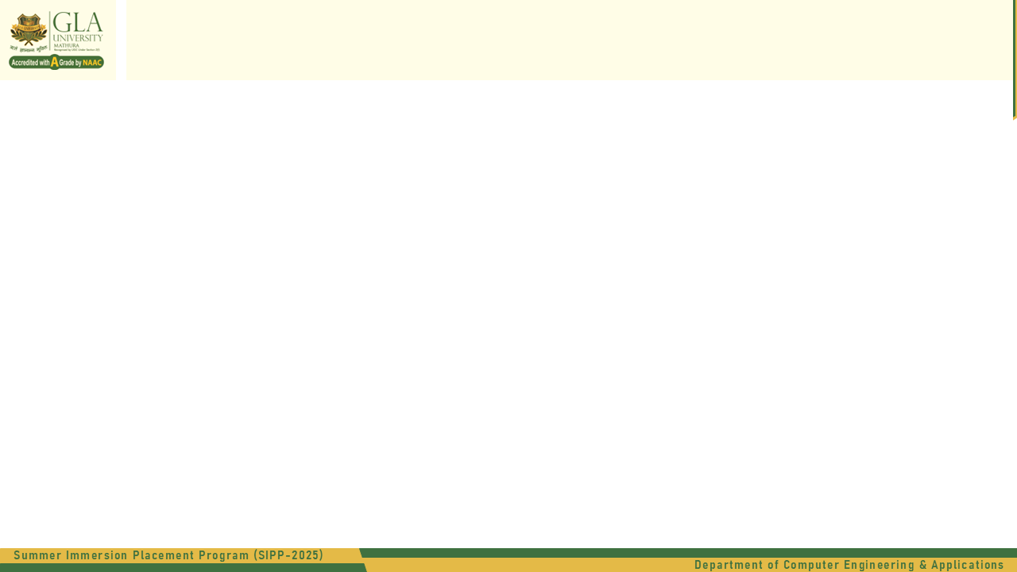
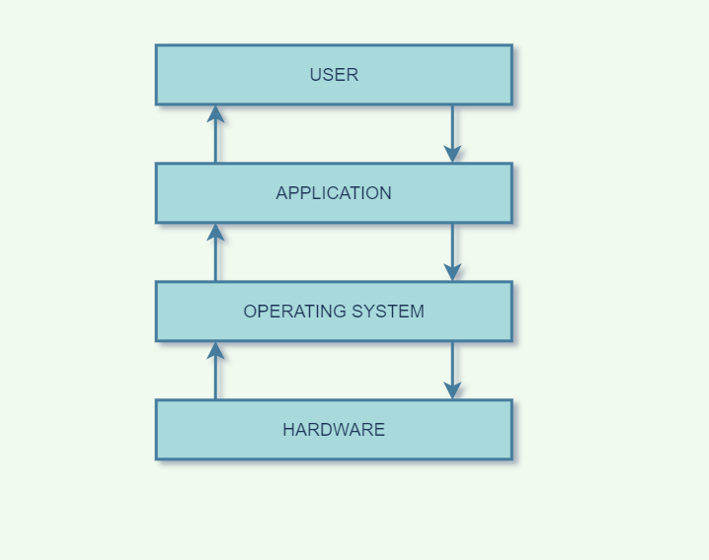
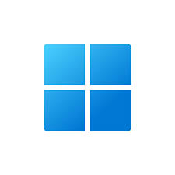


What is an Operating System?
An Operating System (OS) is system software that manages computer hardware and software resources
Acts as an intermediary between user and hardware.
Examples: Windows, macOS, Linux, Android

Slide 3
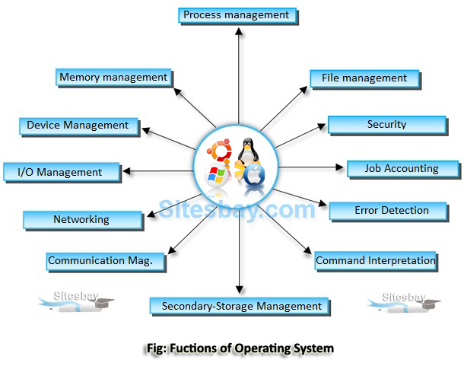
Functions of Operating System?
Process Management
Memory Management
File System Management
Device Management
Security & Access Control
User Interface

Slide 4
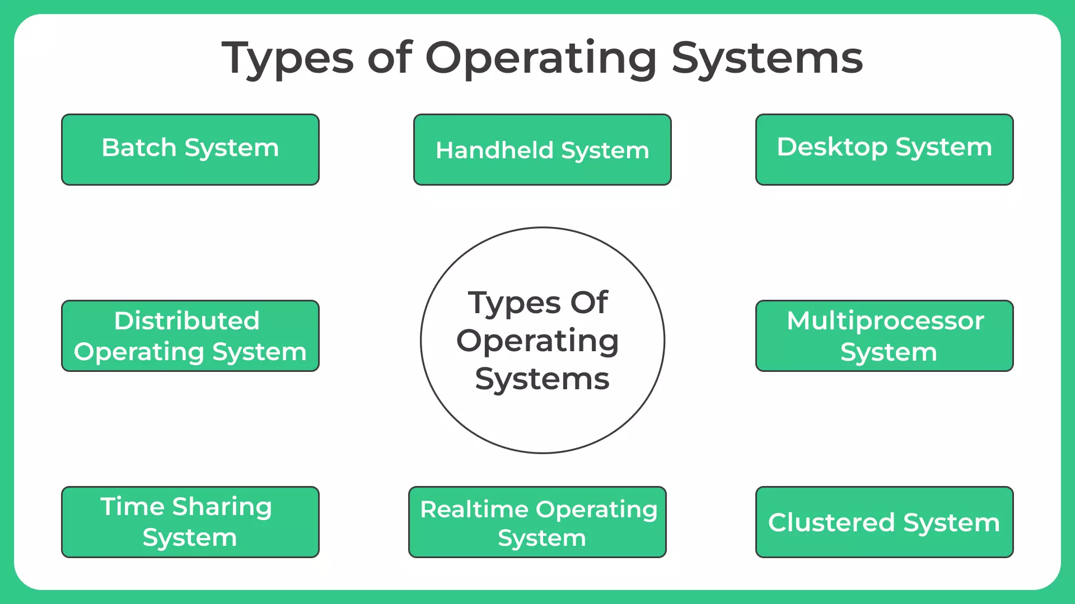
Types of Operating Systems

Slide 5
Types of Operating Systems
Batch Operating System
No direct interaction with the user
Jobs processed in batches
Example: IBM OS/360
Time-Sharing Operating System
Allows multiple users to share system resources simultaneously
Quick context switching
Example: UNIX
Distributed Operating System
Manages a group of independent computers as a single system
Promotes resource sharing
Example: LOCUS, Amoeba

Slide 6
Types of Operating Systems
4. Network Operating System (NOS)
Provides services over a network
Example: Novell NetWare, Windows Server
5. Real-Time Operating System (RTOS)
Responds to input within strict time constraints
Used in embedded systems, robots
Example: VxWorks, FreeRTOS
6. Mobile Operating System
Designed for mobile devices
Example: Android, iOS

Slide 7
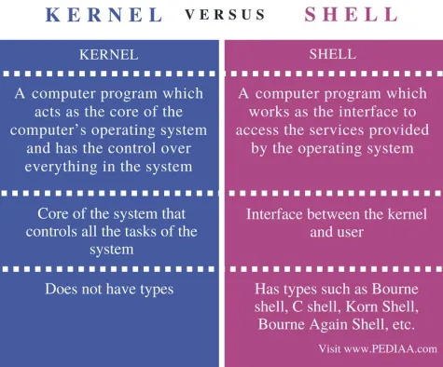
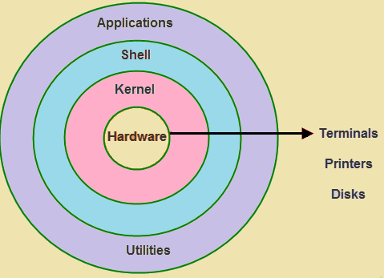
Kernel vs Shell

Slide 8
What is the shell advantages?
It allows you to interact with the computer by typing commands and executing them.
It acts as a command-line interpreter, taking your input, interpreting it, and executing the corresponding actions.
It allows you to automate repetitive tasks by creating scripts or shell programs.
It provides direct access to the system's utilities and functions, enabling efficient management and control over your computer.
It offers flexibility, as you can customize and extend its functionality according to your needs.

Slide 9
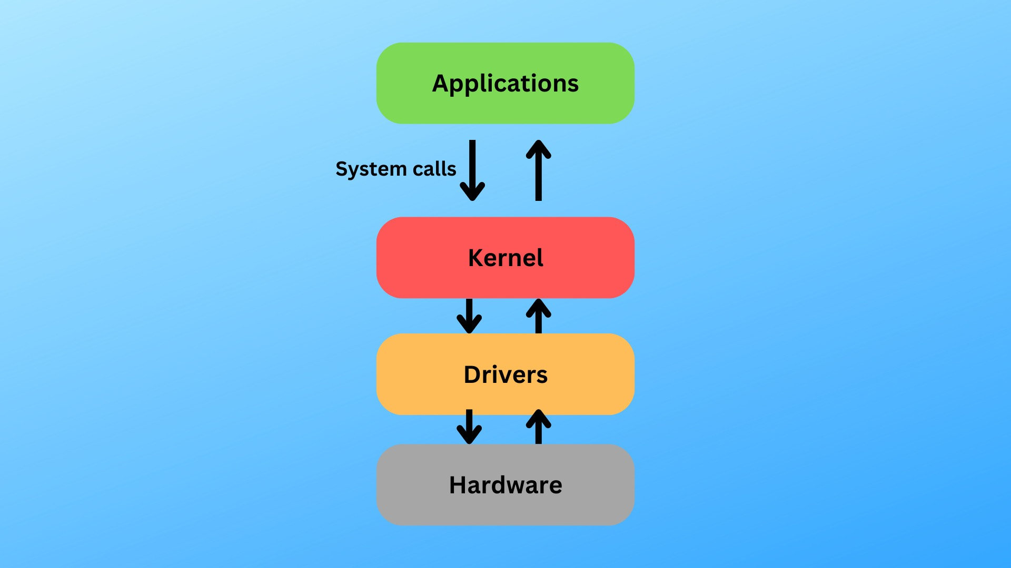
What are System Calls?
Interface between user applications and the OS.
Provides services like:
- Process Control
- File Management
- Device Management
- Information Maintenance
- Communication

Slide 10
Shell vs System Calls
Feature | Shell | System Calls
Definition | User interface for the OS | Low-level interface to the kernel
Function | Interprets user commands | Requests services from the kernel
Level | Higher-level, user-facing | Lower-level, kernel-facing
Examples | Bash, PowerShell, Zsh | open(), read(), write(), fork()
Relationship | Interacts with kernel via system calls | Used by applications and shells

Slide 11

System Architecture Overview
Defines how OS components are organized and interact.
Three Common Architectures:
1.Monolithic Architecture
2. Layered Architecture:
3. Microkernel Architecture:

Slide 12
1. Monolithic Architecture
Description: All OS components (like the kernel, device drivers, file system, etc.) are integrated into a single, large program that runs in kernel space.
Advantages: Simple to implement, fast due to direct communication between components.
Disadvantages: Difficult to debug and update, a bug in one component can potentially crash the entire system.
Examples: Early versions of Unix, MS-DOS.

Slide 13
2. Layered Architecture:
Description: The OS is structured into multiple layers, with each layer built upon the lower layers.
Advantages: Modularity, easier debugging and maintenance, improved security due to isolation of layers.
Disadvantages: Can be slower than monolithic due to inter-layer communication overhead.
Examples: Some implementations of Unix, many modern operating systems.

Slide 14
3. Microkernel Architecture:
Description:The kernel provides only minimal functionalities (like memory management, inter-process communication), while other services (like device drivers, file systems) run as user-level processes.
Advantages:High modularity, improved security and reliability, easier to extend and maintain.
Disadvantages:Can have performance overhead due to increased inter-process communication.
4. Examples:Mach, MINIX.

